Slide 1
Dealing with Generalization, Bias-Variance Trade-Off & The EMSE Equation
Damian A. Tamburri, Ph.D.

Slide 2
Bias-Variance Trade-offs & EMSE: Outline
Generalization foundations
Bias-variance trade-off!
Getting it done with Generalization
Simple examples of bias/variance
Mathematical definition
Measuring/Reducing Effect of bias, variance and error
Bagging as a way to reduce variance
Bias-variance final considerations for classification

Slide 3
But first, Recap! Why machine learning?
Extract knowledge/information from past experience/data
Different strategies to do so (decision-tree learning, Bayesian, instance-based …)
Use this knowledge/information to analyze new experiences/data
Designing rules to deal with new data by hand can be difficult
E.g., how to write a program that detects cats in images?
Collecting data can be easier
Find images with cats, and ones without them
Use machine learning to automatically find such rules.

Slide 4
But first, Recap! Why machine learning?
Extract knowledge/information from past experience/data
Different strategies to do so (decision-tree learning, Bayesian, instance-based …)
Use this knowledge/information to analyze new experiences/data
Designing rules to deal with new data by hand can be difficult
How to write a program that detects cats in images?
Collecting data can be easier
Find images with cats, and ones without them
Use machine learning to automatically find such rules.

Slide 5

A familiar example...
Image classification

Slide 6
A familiar example...
Image classification problem: ?

Slide 7
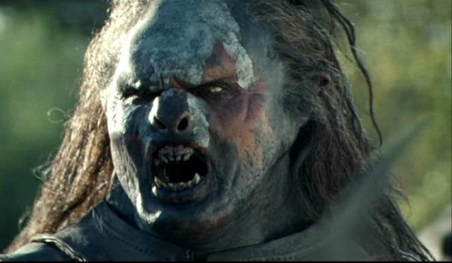
A familiar example...
Image classification problem: FIND THE HUMAN!
Notes:
Suppose you are an Orc… and you’re old, the battle for middle-earth is long over and age has taken over you so you don’t see too well, so you want some sort of visual aid to identify humans or you’ll starve to death

Slide 8
A familiar example...
Image classification problem: FIND THE HUMAN!
Decision-tree learning...

Slide 9
A familiar example...
Image classification problem: FIND THE HUMAN!
Decision-tree learning... Step 1 - Start randomly

Slide 10
A familiar example...
Image classification problem: FIND THE HUMAN!
Decision-tree learning... Step 1 - Start randomly

Slide 11
A familiar example...
Image classification problem: FIND THE HUMAN!
Decision-tree learning... Step 2 – predilect steps with more info content

Slide 12
A familiar example...
Image classification problem: FIND THE HUMAN!
Decision-tree learning... Step 2 – predilect steps with more info content

Slide 13
A familiar example...
Image classification problem: FIND THE HUMAN!
Decision-tree learning... Step 3 – learn!

Slide 14
A familiar example...
Image classification problem: FIND THE HUMAN!
Decision-tree learning... Step 3 – learn!

Slide 15
A familiar example...
Image classification problem: FIND THE HUMAN!
Decision-tree learning... Step 3 – learn!

Slide 16
A familiar example...
Image classification problem: FIND THE HUMAN!
Decision-tree learning... Step 4 – hey, there’s a HUMAN!

Slide 17
A familiar example...
Image classification problem: FIND THE HUMAN!
ANN learning... Step 1 – linear separation

Slide 18
A familiar example...
Image classification problem: FIND THE HUMAN!
ANN learning... Step 1 – linear separation

Slide 19
A familiar example...
Image classification problem: FIND THE HUMAN!
ANN learning... Step 2 – start randomly!

Slide 20
A familiar example...
Image classification problem: FIND THE HUMAN!
ANN learning... Step 3 – error evaluation ➔ lots of error, learn

Slide 21
A familiar example...
Image classification problem: FIND THE HUMAN!
ANN learning... Step 3 – error evaluation ➔ lots of error, learn

Slide 22
A familiar example...
Image classification problem: FIND THE HUMAN!
ANN learning... Step 3 – error evaluation ➔ lots of error, learn

Slide 23
A familiar example...
Image classification problem: FIND THE HUMAN!
ANN learning... Step 3 – error evaluation ➔ lots of error, learn

Slide 24
A familiar example...
Image classification problem: FIND THE HUMAN!
ANN learning... Step 3 – error evaluation ➔ lots of error, learn

Slide 25
A familiar example...
Image classification problem: FIND THE HUMAN!
ANN learning... Step 3 – error evaluation ➔ lots of error, learn

Slide 26
A familiar example...
Image classification problem: FIND THE HUMAN!
ANN learning... Step 3 – error evaluation ➔ still some error, learn

Slide 27
A familiar example...
Image classification problem: FIND THE HUMAN!
ANN learning... Step 3 – error evaluation ➔ still some error, learn

Slide 28
A familiar example...
Image classification problem: FIND THE HUMAN!
ANN learning... Step 3 – error evaluation ➔ still some error, learn

Slide 29
A familiar example...
Image classification problem: FIND THE HUMAN!
ANN learning... Step 3 – error evaluation ➔ still some error, learn

Slide 30
A familiar example...
Image classification problem: FIND THE HUMAN!
ANN learning... Step 3 – error evaluation ➔ still some error, learn

Slide 31
A familiar example...
Image classification problem: FIND THE HUMAN!
ANN learning... Step 3 – error evaluation ➔ still some error, learn

Slide 32
A familiar example...
Image classification problem: FIND THE HUMAN!
ANN learning... Step 3 – error evaluation ➔ still some error, learn

Slide 33
A familiar example...
Image classification problem: FIND THE HUMAN!
ANN learning... Step 3 – error evaluation ➔ hey, there’s a HUMAN!
Notes:
https://github.com/open-dse/architect_big_data_solutions_with_spark

Slide 34
Recap: Steps in machine learning
Data collection & cleaning
“training data”, optionally with “labels” provided by an “oracle”.
Representation (Feature Engineering)
how the data are encoded into “features” when presented to learning algorithm.
Data Inspection & Modeling (Feature Engineering)
choose the class of models that the learning algorithm will choose from.
Estimation (Training with multiple options)
find the model that best explains the data: simple and fits well.
Validation (Test with test data)
evaluate the learned model and compare to solution found using other model classes.
Apply learned model to new “test” data

Slide 35
Recap: Steps in machine learning
Data collection & cleaning
“training data”, optionally with “labels” provided by an “oracle”.
Representation (Feature Engineering)
how the data are encoded into “features” when presented to learning algorithm.
Data Inspection & Modeling (Feature Engineering)
choose the class of models that the learning algorithm will choose from.
Estimation (Training with multiple options)
find the model that best explains the data: simple and fits well.
Validation (Test with test data)
evaluate the learned model and compare to solution found using other model classes.
Apply learned model to new “test” data

Slide 36
Recap: Data Representation
Important issue when using learning techniques
Different types of representations
Vectorial, graphs, …
Homogeneous or heterogeneous, e.g. Images + text
Choice of representation may impact the choice of learning algorithm.
Domain knowledge can help to design or select good features.
The ultimate feature would solve the learning problem…
Automatic methods known as “feature selection” methods

Slide 37
Recap: Steps in machine learning
Data collection & cleaning
“training data”, optionally with “labels” provided by an “oracle”.
Representation (Feature Engineering)
how the data are encoded into “features” when presented to learning algorithm.
Data Inspection & Modeling (Feature Engineering)
choose the class of models that the learning algorithm will choose from.
Estimation (Training with multiple options)
find the model that best explains the data: simple and fits well.
Validation (Test with test data)
evaluate the learned model and compare to solution found using other model classes.
Apply learned model to new “test” data

Slide 38
Recap: Probability & Statistics in Learning!
Many learning methods formulated as a probabilistic model of data
Can deal with uncertainty in the data
Missing values for some data can be handled
Provides a unified framework to combine many different models for different types of data
Statistics are used to analyze the behavior of learning algorithms
Does the learning algorithm recover the underlying model given enough data: “consistency”
How fast does is do so: rate of convergence
Common important assumption
Training data sampled from the true data distribution
The test data is sampled from the same distribution

Slide 39
Recap: Steps in machine learning
Data collection & cleaning
“training data”, optionally with “labels” provided by an “oracle”.
Representation (Feature Engineering)
how the data are encoded into “features” when presented to learning algorithm.
Data Inspection & Modeling (Feature Engineering)
choose the class of models that the learning algorithm will choose from.
Estimation (Training with multiple options)
find the model that best explains the data: simple and fits well.
Validation (Test with test data)
evaluate the learned model and compare to solution found using other model classes.
Apply learned model to new “test” data

Slide 40
Recap: Different forms of learning
Supervised
Classification
Regression
Unsupervised
Clustering
Dimension reduction
Topic models
Density estimation
Semi-supervised
Combine labeled data with unlabeled data
Active learning
Determine the most useful data to label next
Many other forms…

Slide 41
Recap: Different forms of learning
Supervised
Classification
Regression
Unsupervised
Clustering
Dimension reduction
Topic models
Density estimation
Semi-supervised
Combine labeled data wit unlabeled data
Active (or Deep) learning
Determine the most useful data to label next
Many other forms…

Slide 42
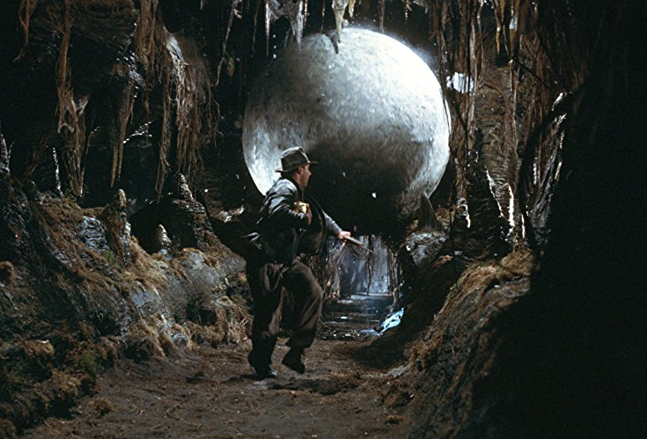
Now what?
Here comes the trouble...

Slide 43
Bias-Variance Trade-offs & EMSE: Outline
Generalization foundations
Bias-variance trade-off!
Getting it done with Generalization
Simple examples of bias/variance
Mathematical definition
Measuring/Reducing Effect of bias, variance and error
Bagging as a way to reduce variance
Bias-variance final considerations for classification

Slide 44

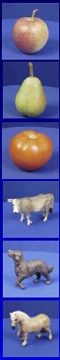
Generalization*
Training set (labels known)
Test set (labels unknown)
How well does a learned model generalize from the data it was trained on, to a new test-set?
* Many slides adapted from Dr. S. Lazebnik

Slide 45
Generalization
The ultimate goal is to do as well as possible on new, unseen data (a test set), but we only have access to labels (“ground truth”) for the training set
What makes generalization possible?
(e.g., Inductive) bias! set of assumptions a learner uses to predict the target value for previously unseen inputs
This is the same as modeling or choosing a target hypothesis class
Types of inductive bias
Occam’s razor
Similarity/continuity bias: similar inputs should have similar outputs
…

Slide 46
Achieving good generalization
Consideration 1: Bias
How well does your model fit the observed data?
It may be a good idea to accept some fitting error, because it may be due to noise or other “accidental” characteristics of one particular training set
Consideration 2: Variance
How robust is the model to the selection of a particular training set?
To put it differently, if we learn models on two different training sets, how consistent will the models be?

Slide 47
Estimating Generalization Error
The basic problem: Once I’ve built a classifier, how accurate will it be on future test data?
Problem of Induction: “It’s hard to make predictions, especially about the future” Cit. [Yogi Bear]
Cross-validation: clever computation on the training data to predict test performance.
Research Today: Theoretical insights into generalization performance.
Notes:
building a classifier may involve setting parameters

Slide 48
So… Generalization
Components of generalization error
Bias: how much does the average model trained over all available training sets differ from the true model?
Error due to inaccurate assumptions/simplifications made by the model
Variance: how much do models estimated from different training sets differ from each other?
Underfitting: model is too “simple” to represent all the relevant class characteristics
High bias and low variance
High training error and high test error
Overfitting: model is too “complex” and fits irrelevant characteristics (noise) in the data
Low bias and high variance
Low training error and high test error
Slide credit: L. Lazebnik

Slide 49
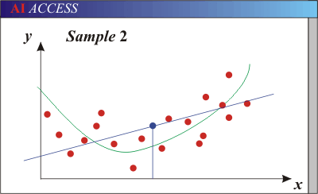
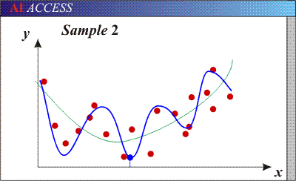
Bias-Variance Trade-off
Models with too few parameters are inaccurate because of a large bias (not enough flexibility).
Models with too many parameters are inaccurate because of a large variance (too much sensitivity to the sample).
Slide credit: D. Hoiem
Notes:
http://www.aiaccess.net/English/Glossaries/GlosMod/e_gm_bias_variance.htm

Slide 50
Dart Example

Slide 51
Bias-variance tradeoff: Quality of training
Underfitting
Overfitting
Error
Test error
Training error
High Bias
Low Variance
Complexity
Low Bias
High Variance
Slide credit: D. Hoiem

Slide 52
Bias-variance tradeoff: Quantity of Training
Few training examples
Test Error
Many training examples
High Bias
Low Variance
Complexity
Low Bias
High Variance
Slide credit: D. Hoiem
Notes:
Note: these figures don’t work in pdf

Slide 53
Effect of Training Size
Fixed prediction model
Error
Testing
Generalization Error
Training
Number of Training Examples
Slide credit: D. Hoiem

Slide 54
Ok, let’s get serious...
How do we define the generalization error and how can we improve it?

Slide 55
Ok, let’s get serious...
How do we define the generalization error and how can we improve it?
There’s 2 problems with it, but first, a bit of juicy math…

Slide 56
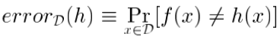
Ok, let’s get serious...
How do we define the generalization error and how can we improve it?
True Error:
“the true error of hypothesis h with respect to target function f and distribution D is the probability that h misclassifies an instance drawn at random according to D:
”

Slide 57
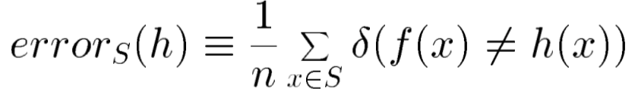
Ok, let’s get serious...
Sample Error:
“the sample error of hypothesis H with respect to target function f and data sample S is the proportion of examples that H misclassifies:
”

Slide 58
So our original question becomes...
How well does error_{S}(H) estimate error_{D}(H)?

Slide 59
So our original question becomes...
How well does error_{S}(H) estimate error_{D}(H)?
Problem 1: if S is the sample training set and the selection of S recurs to a strategy, then S is *optimistically biased*.
Notes:
Four factors exist that cause a person to be optimistically biased: their desired end state, their cognitive mechanisms, the information they have about themselves versus others, and overall mood.^{[3}
https://en.wikipedia.org/wiki/Optimism_bias
https://stats.stackexchange.com/questions/88912/optimism-bias-estimates-of-prediction-error
http://www.stat.cmu.edu/~ryantibs/advmethods/notes/df.pdf

Slide 60
So our original question becomes...
How well does error_{S}(H) estimate error_{D}(H)?
Problem 1: if S is the sample training set and the selection of S recurs to a strategy, then S is *optimistically biased*.
Meaning: “the more we depend on the information contained in S to come up with our prediction H, the more overly optimistic our estimator will be;”
Notes:
Four factors exist that cause a person to be optimistically biased: their desired end state, their cognitive mechanisms, the information they have about themselves versus others, and overall mood.^{[3}
https://en.wikipedia.org/wiki/Optimism_bias
https://stats.stackexchange.com/questions/88912/optimism-bias-estimates-of-prediction-error

Slide 61
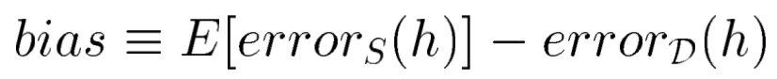
So our original question becomes...
How well does error_{S}(H) estimate error_{D}(H)?
Problem 1: if S is the sample training set and the selection of S recurs to a strategy, then S is *optimistically biased*.
Bias: “the more we depend on the information contained in S to come up with our prediction H, the more overly optimistic our estimator will be;”
Notes:
Four factors exist that cause a person to be optimistically biased: their desired end state, their cognitive mechanisms, the information they have about themselves versus others, and overall mood.^{[3}
https://en.wikipedia.org/wiki/Optimism_bias
https://stats.stackexchange.com/questions/88912/optimism-bias-estimates-of-prediction-error

Slide 62
So our original question becomes...
How well does error_{S}(H) estimate error_{D}(H)?
Problem 1: if S is the sample training set and the selection of S recurs to a strategy, then S is *optimistically biased*.
Bias
Avoiding problem 1: select S and H independently
Notes:
Four factors exist that cause a person to be optimistically biased: their desired end state, their cognitive mechanisms, the information they have about themselves versus others, and overall mood.^{[3}
https://en.wikipedia.org/wiki/Optimism_bias
https://stats.stackexchange.com/questions/88912/optimism-bias-estimates-of-prediction-error

Slide 63
So our original question becomes...
How well does error_{S}(H) estimate error_{D}(H)?
Problem 1: if S is the sample training set and the selection of S recurs to a strategy, then S is *optimistically biased*.
Bias
Avoiding problem 1: select S and H independently
Solution: *Unsupervised* learning!
Notes:
Four factors exist that cause a person to be optimistically biased: their desired end state, their cognitive mechanisms, the information they have about themselves versus others, and overall mood.^{[3}
https://en.wikipedia.org/wiki/Optimism_bias
https://stats.stackexchange.com/questions/88912/optimism-bias-estimates-of-prediction-error

Slide 64
So our original question becomes...
How well does error_{S}(H) estimate error_{D}(H)?
Problem 2
Bias-Variance Trade-off!
Notes:
Four factors exist that cause a person to be optimistically biased: their desired end state, their cognitive mechanisms, the information they have about themselves versus others, and overall mood.^{[3}
https://en.wikipedia.org/wiki/Optimism_bias
https://stats.stackexchange.com/questions/88912/optimism-bias-estimates-of-prediction-error

Slide 65
Bias-Variance Trade-off
E(MSE) = noise + bias² + variance
Error due to variance of training samples
Unavoidable error
Error due to incorrect assumptions
See the following for explanations of the math behind bias-variance (also Bishop’s “Neural Networks” book):
http://www.inf.ed.ac.uk/teaching/courses/mlsc/Notes/Lecture4/BiasVariance.pdf
Slide credit: D. Hoiem
Notes:
Expectation of the Mean-Squared Error for the ML campaign.
From the link above:
You can only get generalization through assumptions.
Thus in order to minimize the MSE, we need to minimize both
the bias and the variance. However, this is not trivial to do this. For instance, just
neglecting the input data and predicting the output somehow (e.g., just a constant), would definitely minimize the variance of our predictions: they would be
always the same, thus the variance would be zero—but the bias of our estimate
(i.e., the amount we are off the real function) would be tremendously large. On
the other hand, the neural network could perfectly interpolate the training data,
i.e., it predict y=t for every data point. This will make the bias term vanish entirely, since the E(y)=f (insert this above into the squared bias term to verify this),
but the variance term will become equal to the variance of the noise, which may
be significant (see also Bishop Chapter 9 and the Geman et al. Paper). In general,
finding an optimal bias-variance tradeoff is hard, but acceptable solutions can be
found, e.g., by means of cross validation or regularization.

Slide 66
In summary… The Bias-Variance Trade-off
The Short Story: Bias and variance typically trade off in relation to model complexity.
Model complexity
-
+
Bias
Variance
+
+
Error

Slide 67
The long story: Bias-Variance Decomposition for Target Values
Observed Target Value t(x) = h(x) + noise.
Can do the same analysis for t(x) rather than h(x).
Result: average squared prediction error = bias² + variance+ average noise
Notes:
insert Bishop’s figure
As we increase the trade-off parameter, we overfit less, so bias goes up and variance goes down.
make sure the figure works on the notebook.

Slide 68
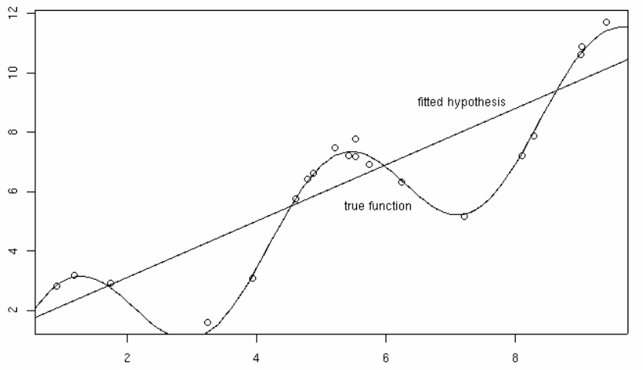
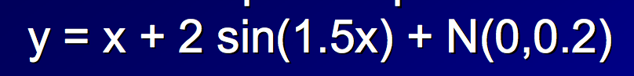
Here’s a real Example
Tom Dietterich, Oregon St

Slide 69
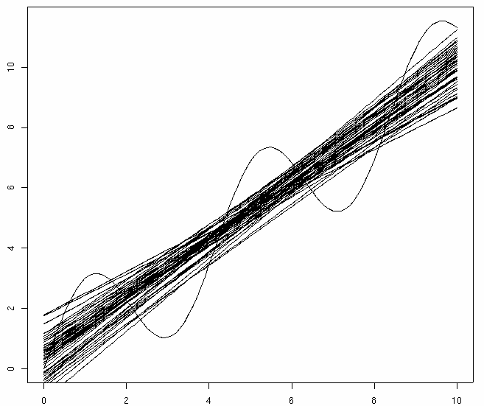
Example
Tom Dietterich, Oregon St
Same experiment, repeated:
with 50 samples of 20 points each

Slide 70
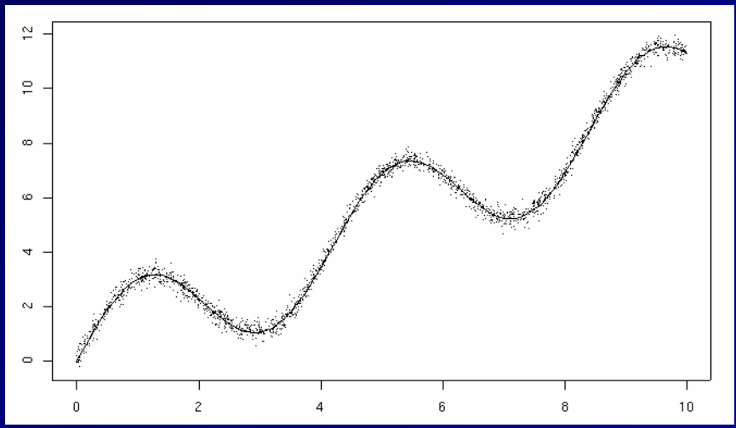
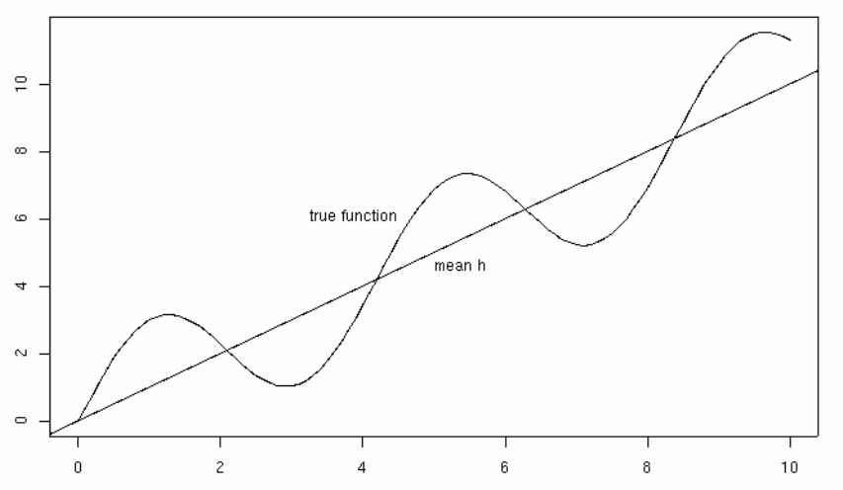
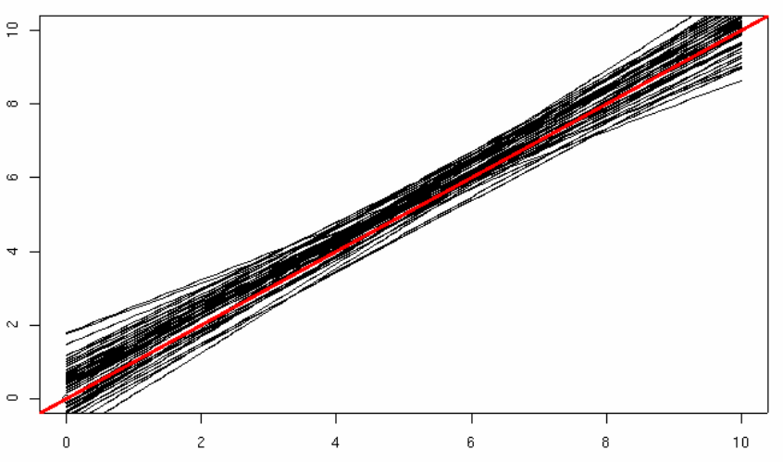
The true function f can’t be fit perfectly with hypotheses from our class H
(lines) ➔ Error₁
noise is similar to error₁
Fix: more expressive set of hypotheses H
We don’t get the best hypothesis from H because of noise/small sample size ➔ Error₂
Fix: less expressive set of hypotheses H

Slide 71
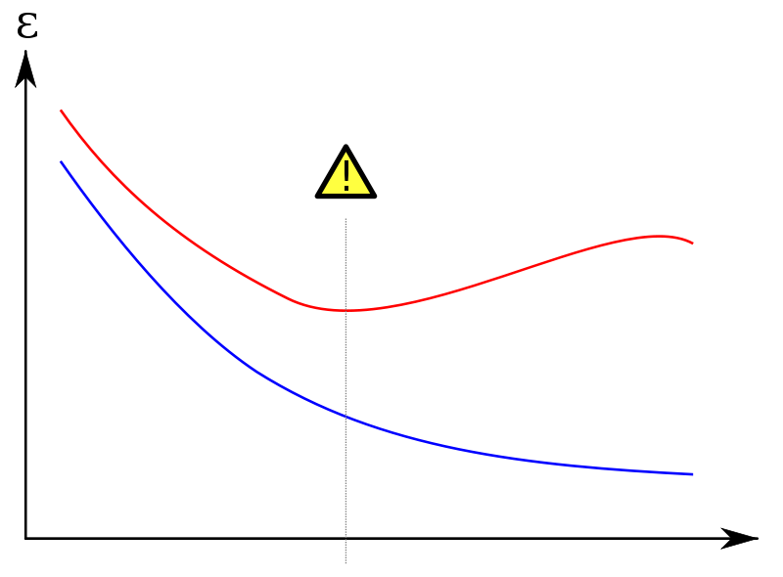
In Summary, Bias/Variance...
Practical way to Understand Overfitting and Underfitting
high error
“too simple”
“too complex”
Error/Loss on an unseen test set D^{test}
Error/Loss on training set D^{train}
simple classifier
complex classifier
71

Slide 72

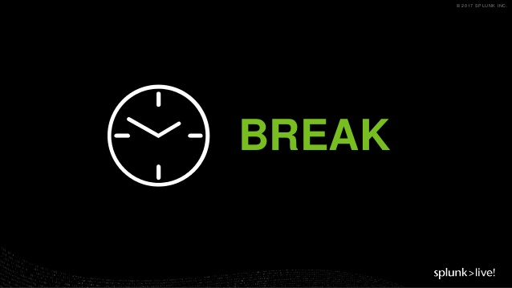
15 min Break?
Up next, fixing B/V in ML...

Slide 73
Summary: dealing with Bias-variance Trade-offs during ML Experimentation
This is something real that you can (approximately) measure experimentally
if you have synthetic data
Different learners and model classes have different tradeoffs
large bias/small variance: few features, highly regularized, highly pruned decision trees, large-k in k-NN…
small bias/high variance: many features, less regularization, un-pruned trees, small-k in k-NN…
Notes:
Mention that the Modelling course will be covering it in more details

Slide 74
Bias-Variance Trade-off Effect Reduction

Slide 75
Bias-variance decomposition
This is something real that you can (approximately) measure experimentally
if you have synthetic data
…or if you’re clever
You need to somehow approximate E_{D}{h_{D}(x)}
…

Slide 76

Bias-variance decomposition
This is something real that you can (approximately) measure experimentally
if you have synthetic data
…or if you’re clever
You need to somehow approximate E_{D}{h_{D}(x)}
…
<MOMENT OF SUSPENSE>

Slide 77
Bias-variance decomposition
This is something real that you can (approximately) measure experimentally
if you have synthetic data
…or if you’re clever
You need to somehow approximate E_{D}{h_{D}(x)}
I.e., construct many variants of the dataset D

Slide 78
Background: “Bootstrap” sampling
Input: dataset D
Output: many variants of D: D₁,…,D_{T}
For t=1,….,T:
D_{t} = { }
For i=1…|D|:
Pick (x,y) uniformly at random from D (i.e., with replacement) and add it to D_{t}
Some examples never get picked (~37%)
Some are picked 2x, 3x, ….

Slide 79
Tackling Bias-Variance with “Bootstrap” sampling
Create B bootstrap variants of D (approximate many draws of D)
For each bootstrap dataset
T_{b} is the dataset; U_{b} are the “out of bag” examples
Train a hypothesis h_{b} on T_{b}
Test h_{b} on each x in U_{b}
Now for each (x,y) example we have many predictions h₁(x),h₂(x), …. so we can estimate (ignoring noise)
variance: ordinary variance of h₁(x),….,h_{n}(x)
bias: average(h₁(x),…,h_{n}(x)) - y

Slide 80
Applied Bias-Variance Analysis
Measure the bias and variance on a problem,
Determine how to improve our model
If bias is high, we need to allow our model to be more complex
If variance is high, we need to reduce the complexity of the model
Bias-variance analysis also suggests a way to reduce variance...

Slide 81
Applied Bias-Variance Analysis
Measure the bias and variance on a problem,
Determine how to improve our model
If bias is high, we need to allow our model to be more complex
If variance is high, we need to reduce the complexity of the model
Bias-variance analysis also suggests a way to reduce variance... bagging!

Slide 82
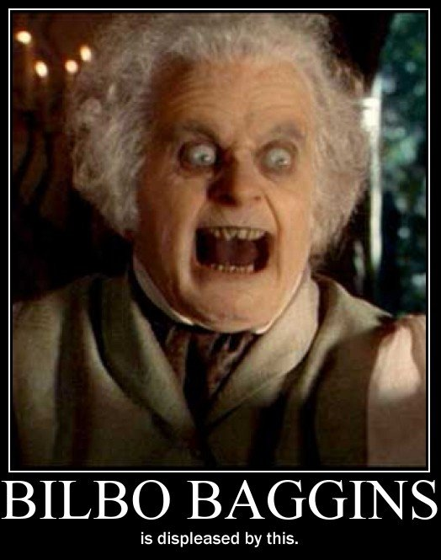
Applied Bias-Variance Analysis: Bagging!

Slide 83
Bootstrap Aggregation (Bagging)
Use the bootstrap to create B variants of D
Learn a classifier from each variant
Vote the learned classifiers to predict on a test example
Notes:
Given a standard training set D {\displaystyle D} of size n, bagging generates m new training sets D i {\displaystyle D_{i}} , each of size n′, by sampling from D uniformly and with replacement. By sampling with replacement, some observations may be repeated in each D i {\displaystyle D_{i}} . If n′=n, then for large n the set D i {\displaystyle D_{i}} is expected to have the fraction (1 - 1/e) (≈63.2%) of the unique examples of D, the rest being duplicates.^{[1]} This kind of sample is known as a bootstrap sample. The m models are fitted using the above m bootstrap samples and combined by averaging the output (for regression) or voting (for classification).
Bootstrapping - In statistics, bootstrapping is any test or metric that relies on random sampling with replacement. Bootstrapping is the practice of estimating properties of an estimator (such as its variance) by measuring those properties when sampling from an approximating distribution.

Slide 84
Bagging (bootstrap aggregation)
Breaking it down:
input: dataset D and YFCL
output: a classifier h_{D-BAG}
use bootstrap to construct variants D₁,…,D_{T}
for t=1,…,T: train YFCL on D_{t} to get h_{t}
to classify x with h_{D-BAG}
classify x with h₁,….,h_{T} and predict the most frequently predicted class for x (majority vote)
Note that you can use any learner you like!
You can also test h_{t} on the “out of bag” examples

Slide 85
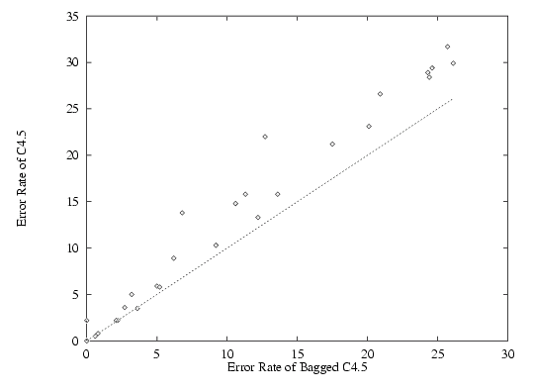
Experiments
Freund and Schapire

Slide 86
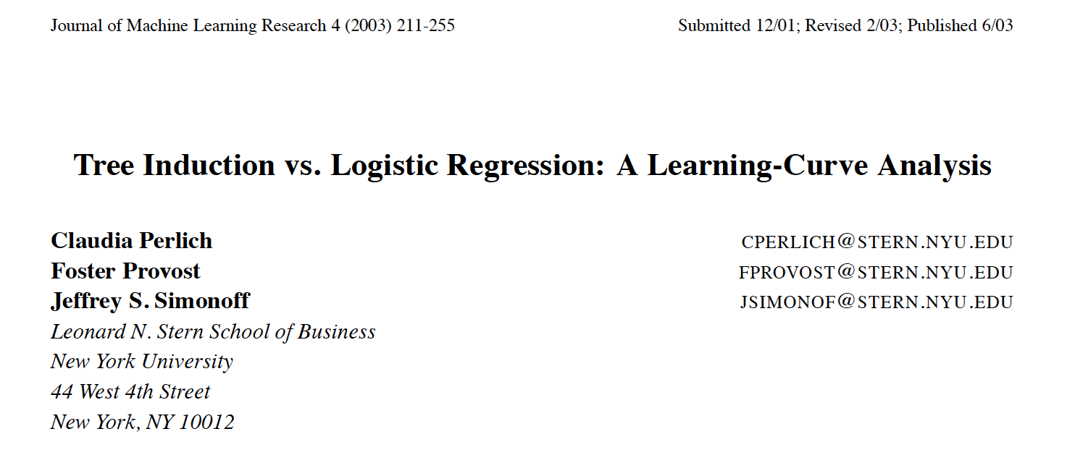
Bagged, minimally pruned decision trees

Slide 87
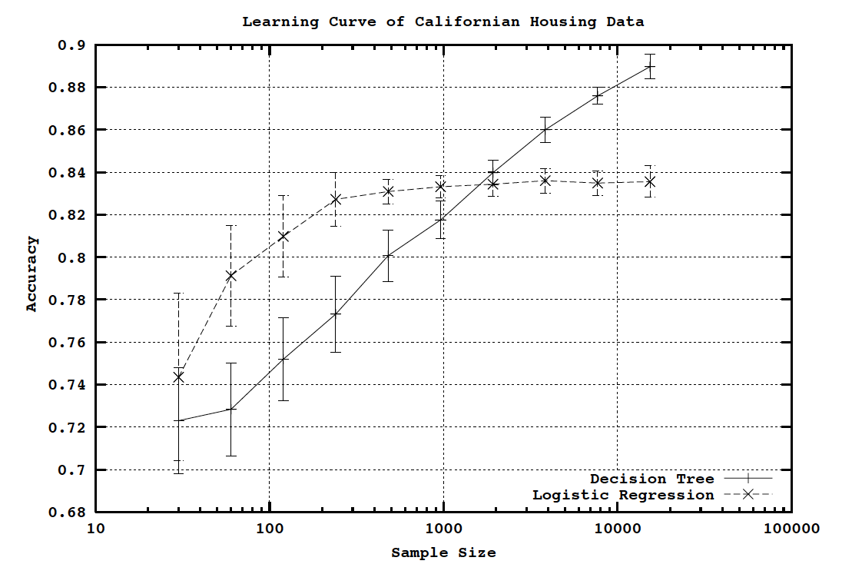

Slide 88
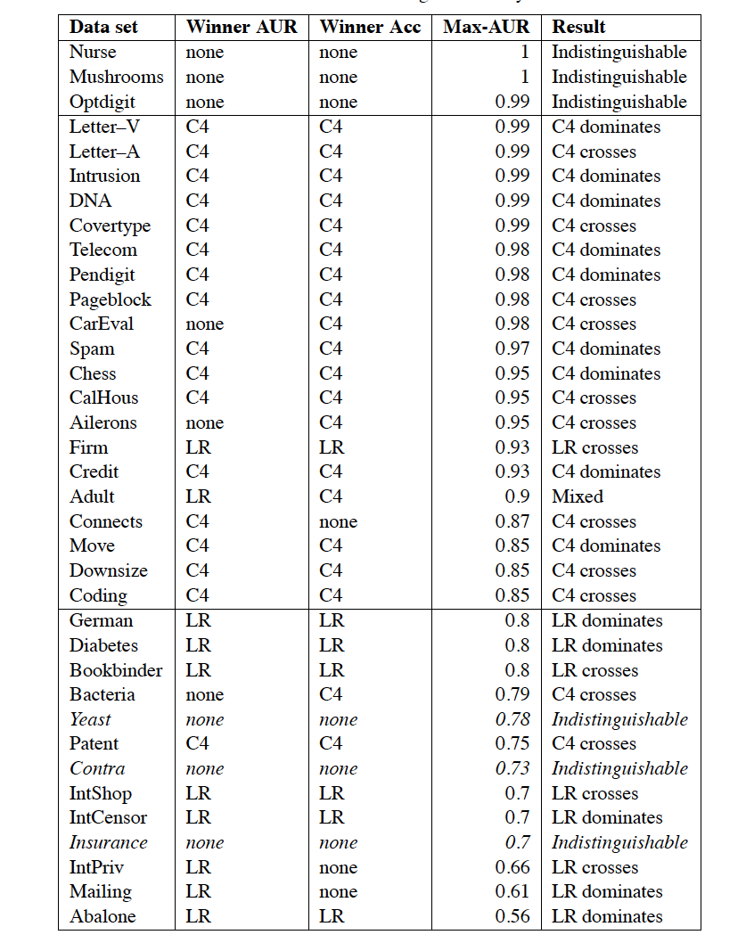
Generally, bagged decision trees outperform the linear classifier eventually if the dataset is large enough and clean enough.

Slide 89
Bagging (bootstrap aggregation)
Experimentally:
especially with minimal pruning: decision trees have low bias but high variance;
bagging usually improves performance for decision trees and similar methods;
It reduces variance without increasing the bias (too much);

Slide 90
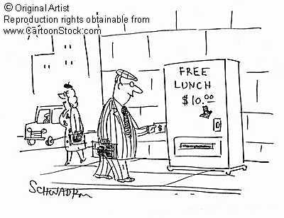
Remember…
No classifier is inherently better than any other: you need to make assumptions to generalize
Three kinds of error
Inherent: unavoidable
Bias: due to over-simplifications
Variance: due to inability to perfectly estimate parameters from limited data
Slide credit: D. Hoiem
Notes:
You can only get generalization through assumptions.

Slide 91
Remember…
No classifier is inherently better than any other: you need to make assumptions to generalize
Three kinds of error
Inherent: unavoidable
Bias: due to over-simplifications
Variance: due to inability to perfectly estimate parameters from limited data
Decompose them for your problem, study where/how they relate to data, to address them. Bagging is one way. *Not* the only way!
Slide credit: D. Hoiem
Notes:
You can only get generalization through assumptions.

Slide 92
Remember…
No classifier is inherently better than any other: you need to make assumptions to generalize
Three kinds of error
Inherent: unavoidable
Bias: due to over-simplifications
Variance: due to inability to perfectly estimate parameters from limited data
NO FREE LUNCH!
Slide credit: D. Hoiem
Notes:
You can only get generalization through assumptions.

Slide 93
Good generalization: Square 1
Consideration 1: Bias
How well does your model fit the observed data?
It may be a good idea to accept some fitting error, because it may be due to noise or other “accidental” characteristics of one particular training set
Consideration 2: Variance
How robust is the model to the selection of a particular training set?
To put it differently, if we learn models on two different training sets, how consistent will the models be?

Slide 94
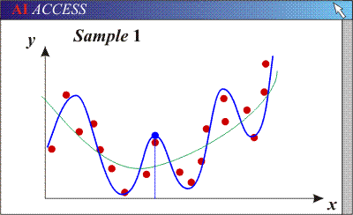

Bias/variance tradeoff
Models with too many parameters may fit the training data well (low bias), but are sensitive to choice of training set (high variance)

Slide 95
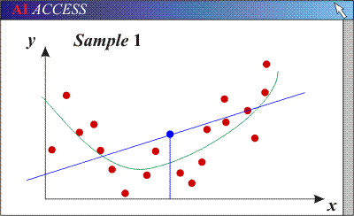
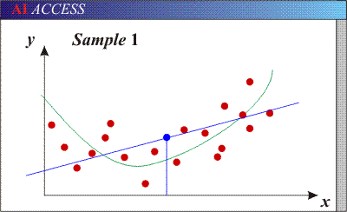
Bias/variance tradeoff
Models with too many parameters may fit the training data well (low bias), but are sensitive to choice of training set (high variance)
Models with too few parameters may not fit the data well (high bias) but are consistent across different training sets (low variance)
2

Slide 96
Bias/variance tradeoff
Models with too many parameters may fit the training data well (low bias), but are sensitive to choice of training set (high variance)
Generalization error is due to overfitting
Models with too few parameters may not fit the data well (high bias) but are consistent across different training sets (low variance)
Generalization error is due to underfitting
2

Slide 97
Underfitting and overfitting
How to recognize underfitting?
High training error and high test error
How to deal with underfitting?
Find a more complex model
How to recognize overfitting?
Low training error, but high test error
How to deal with overfitting?
Get more training data
Decrease the number of parameters in your model
Regularization: penalize certain parts of the parameter space or introduce additional constraints to deal with a potentially ill-posed problem and features

Slide 98
Final Note 1. ML Methodology
Distinction between training and testing is crucial
Correct performance on training set is just memorization!
Not enough to perform well on new test data
Strictly speaking, the researcher should never look at the test data when designing the system
Generalization performance should be evaluated on a hold-out or validation set
Raises some troubling issues for learning “benchmarks”
Source: R. Parr

Slide 99
Final Note 2. Training Error and Cross-Validation
Suppose we use the training error to estimate the difference between the true model prediction P and the learned model prediction L(P):
The training error is downward biased: on average it underestimates the generalization error;
Cross-validation is nearly unbiased since it *always* slightly overestimates the generalization error;
Notes:
the average difference over datasets, between training error and average generalization error.
https://www.disei.unifi.it/upload/sub/pubblicazioni/repec/pdf/wp02_2017.pdf

Slide 100
Final Note 3. Classification
Can do bias-variance analysis for classifiers as well.
General principle: variance dominates bias.
Very roughly, this is because we only need to make a discrete decision rather than get an exact value.
Notes:
(not in Bishop; see Duda and Hart)

Slide 101
Conclusions & Rules of thumb: How to reduce variance?
Choose a simpler classifier first – starting from a simple classifier will make sure you gradually understand yourself the features that need detection and how to address them;
Regularize the parameters - reduce the variance of the estimator by simplifying it; use something that will increase the bias in such a way that the expected error decreases… e.g., by adding a regularization term to prevent coefficients to fit so perfectly and overfit.
Get more training data – e.g., choose different sampling strategy, adopt multiple samplings and compare, use CV…
Slide credit: D. Hoiem
Notes:
The simpler classifier or regularization could increase bias and lead to more error.
it adds a regularization term in order to prevent the coefficients to fit so perfectly to overfit. The difference between the L1 and L2 is just that L2 is the sum of the square of the weights, while L1 is just the sum of the weights.
http://www.chioka.in/differences-between-l1-and-l2-as-loss-function-and-regularization/

Slide 102

Questions?
Thanks!

Slide 103
More detail on bias-variance and bagging for classification
Thanks Tom Dietterich MLSS 2014

Slide 104
A generalization of bias-variance decomposition to other loss functions
“Arbitrary” real-valued loss L(y,y’)
But L(y,y’)=L(y’,y), L(y,y)=0,
and L(y,y’)!=0 if y!=y’
Define “optimal prediction”:
y* = argmin _{y’} L(t,y’)
Define “main prediction of learner”
y_{m}=y_{m,D} = argmin _{y’} E_{D}{L(y,y’)}
Define “bias of learner”:
Bias(x)=L(y*,y_{m})
Define “variance of learner”
Var(x)=E_{D}[L(y_{m},y)]
Define “noise for x”:
N(x) = E_{t}[L(t,y*)]
Claim:
E_{D,t}[L(t,y) = c₁N(x)+Bias(x)+c₂Var(x)
where
c₁=Pr_{D}[y=y*] - 1
c₂=1 if y_{m}=y*, -1 else
m=|D|
For 0/1 loss, the main prediction is the most common class predicted by h_{D}(x), weighting h’s by Pr(D)
Domingos, A Unified Bias-Variance Decomposition and its Applications, ICML 2000

Slide 105
More detail on Domingos’s model
Noisy channel: y_{i} = noise(f(x_{i}))
f(x_{i}) is true label of x_{i}
Noise noise(.) may change y → y’
h=h_{D} is learned hypothesis
from D={(x₁,y₁),…(x_{m},y_{m})}
for test case (x*,y*), and predicted label h(x*), loss is L(h(x*),y*)
For instance, L(h(x*),y*) = 1 if error, else 0

Slide 106
More detail on Domingos’s model
We want to decompose E_{D,P}{L(h(x*),y*)} where m is size of D, (x*,y*)~P
Main prediction of learner is y_{m}(x*)
y_{m}(x*) = argmin _{y’} E_{D,P}{L(h(x*),y’)}
y_{m}(x*) = “most common” h_{D}(x*) among all possible D’s, weighted by Pr(D)
Bias is B(x*) = L(y_{m}(x*) , f(x*))
Variance is V(x*) = E_{D,P}{L(h_{D}(x*) , y_{m}(x*) )
Noise is N(x*)= L(y*, f(x*))

Slide 107
More detail on Domingos’s model
We want to decompose E_{D,P}{L(h(x*),y*)}
Main prediction of learner is y_{m}(x*)
“most common” h_{D}(x*) over D’s for 0/1 loss
Bias is B(x*) = L(y_{m}(x*) , f(x*))
main prediction vs true label
Variance is V(x*) = E_{D,P}{L(h_{D}(x*) , y_{m}(x*) )
this hypothesis vs main prediction
Noise is N(x*)= L(y*, f(x*))
true label vs observed label

Slide 108
More detail on Domingos’s model
We will decompose E_{D,P}{L(h(x*),y*)} into
Bias is B(x*) = L(y_{m}(x*) , f(x*))
main prediction vs true label
this is 0/1, not a random variable
Variance is V(x*) = E_{D,P}{L(h_{D}(x*) , y_{m}(x*) )
this hypothesis vs main prediction
Noise is N(x*)= L(y*, f(x*))
true label vs observed label

Slide 109
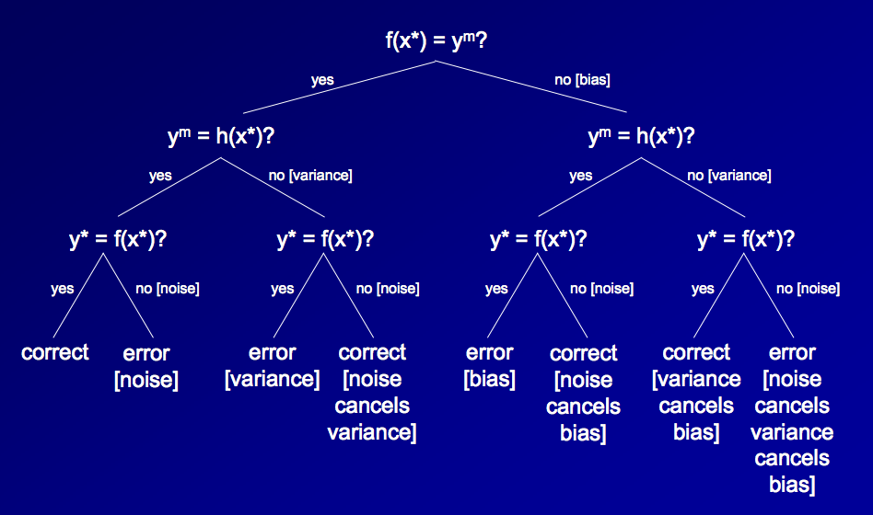
Case analysis of error

Slide 110
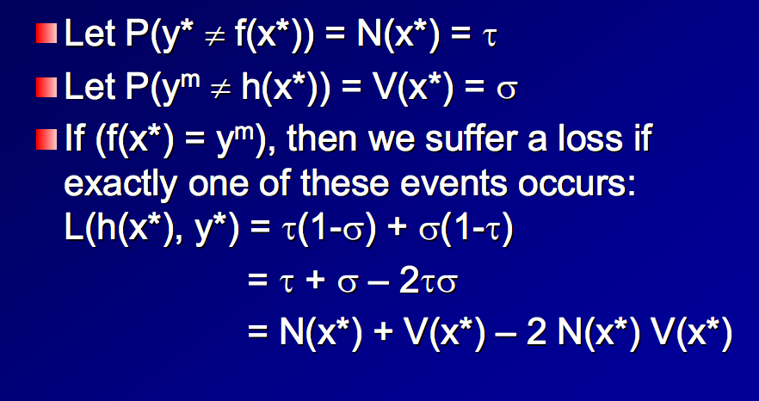
Analysis of error: unbiased case
Variance but no noise
Main prediction is correct
Noise but no variance

Slide 111
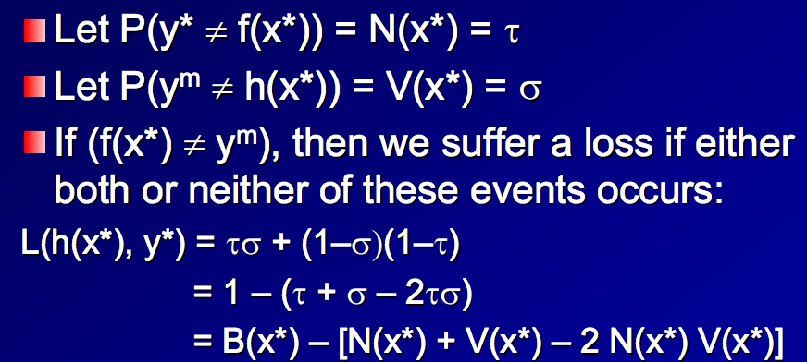
Analysis of error: biased case
No noise, no variance
Main prediction is wrong
Noise and variance

Slide 112
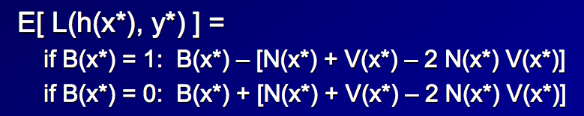
Analysis of error: overall
Hopefully we’ll be in this case more often, if we’ve chosen a good classifier
Interaction terms are usually small

Slide 113
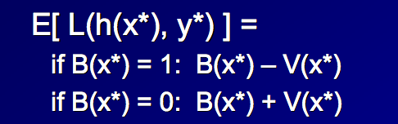
Analysis of error: without noise which is hard to estimate anyway
Vb
Vu
As with regression, we can experimentally approximately measure bias and variance with bootstrap replicates
Typically need to break down variance into biased variance (Vb) and unbiased variance (Vu).

Slide 114
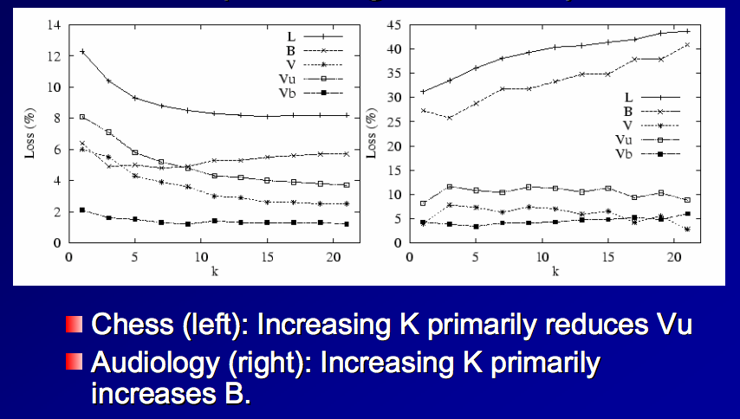
K-NN Experiments

Slide 115
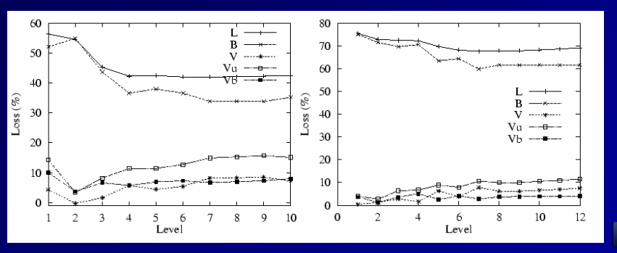
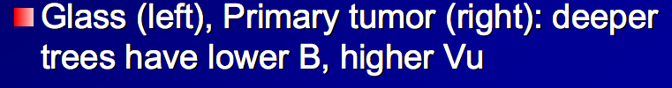
Tree Experiments

Slide 116
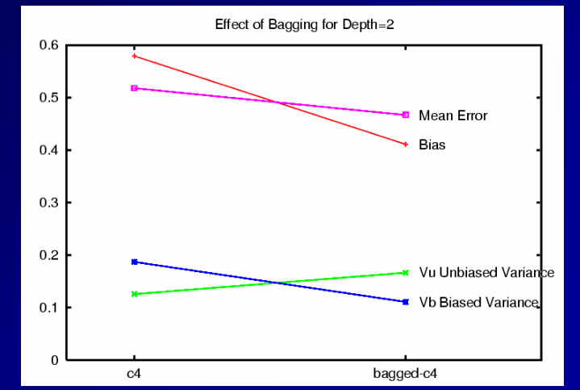
Tree “stump” experiments (depth 2)
Bias is reduced (!)

Slide 117
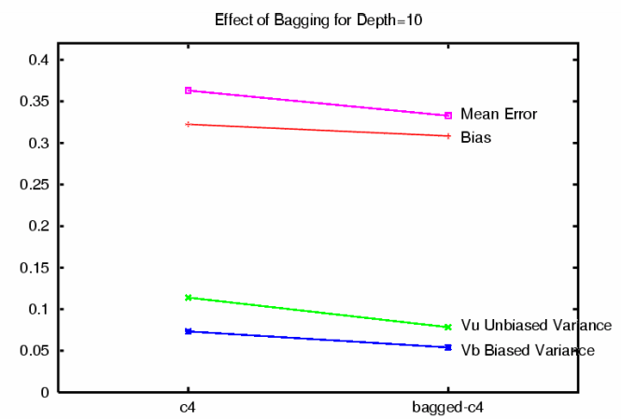
Large tree experiments (depth 10)
Bias is not changed much
Variance is reduced

